Slide 1
NDTwin Network Digital Twin
Where the Failover Time Went
— and what a sample costs
Adam · 2026-08-27

Slide 2
Outline
0
Background
pp. 4–5
What was promised last time, and where the three data planes attach.
1
Answering the open questions
pp. 7–26
The failover budget, faster detection, what a sample costs, and a deadlock in the baseline.
2
Engineering, and what's next
pp. 28–33
Bring-up as one command, truncation and batching, and what the next report will carry.
2

Slide 3
SECTION 0
Background
What was promised last time, and where the three data planes attach
3

Slide 4
Where we left off
Five things were asked for — three on the 20 August closing slide, two in the meetings since. Each came with a test
the test we set ourselves
1
Find where the OVS 128-host recovery time goes
ANSWERED
It balances — and 87% of it is waiting to notice.
detection + recompute + install must add up to 51.75 s
2
Make failure detection faster without making it wrong
ANSWERED
3.9× faster. Idle false positives: zero.
judged on the false-positive rate, not on the detection time
3
Promote the fast bmv2 build to the default
PREREQUISITE
The binaries can be told apart. The suite has not been run.
the whole L0–L4 suite must pass on the fast build
4
Re-measure the sFlow jitter — baseline, and across sampling rates
ANSWERED
Inherited, not ours — and it stops buying precision at 1-in-32.
one fabric, one flow: swap only the kernel binary, then only the sample rate
5
Try packet truncation, and batching
IN PART
Truncation works and buys nothing. Merge is wired and verified; its effect on the ceiling is not measured.
either one moves the sampling ceiling, or the cost is not per byte
Tests 1–3 are quoted verbatim from the 20 August closing slide; 4 and 5 were asked for in the meetings since, and are answered on the same terms.
4

Slide 5
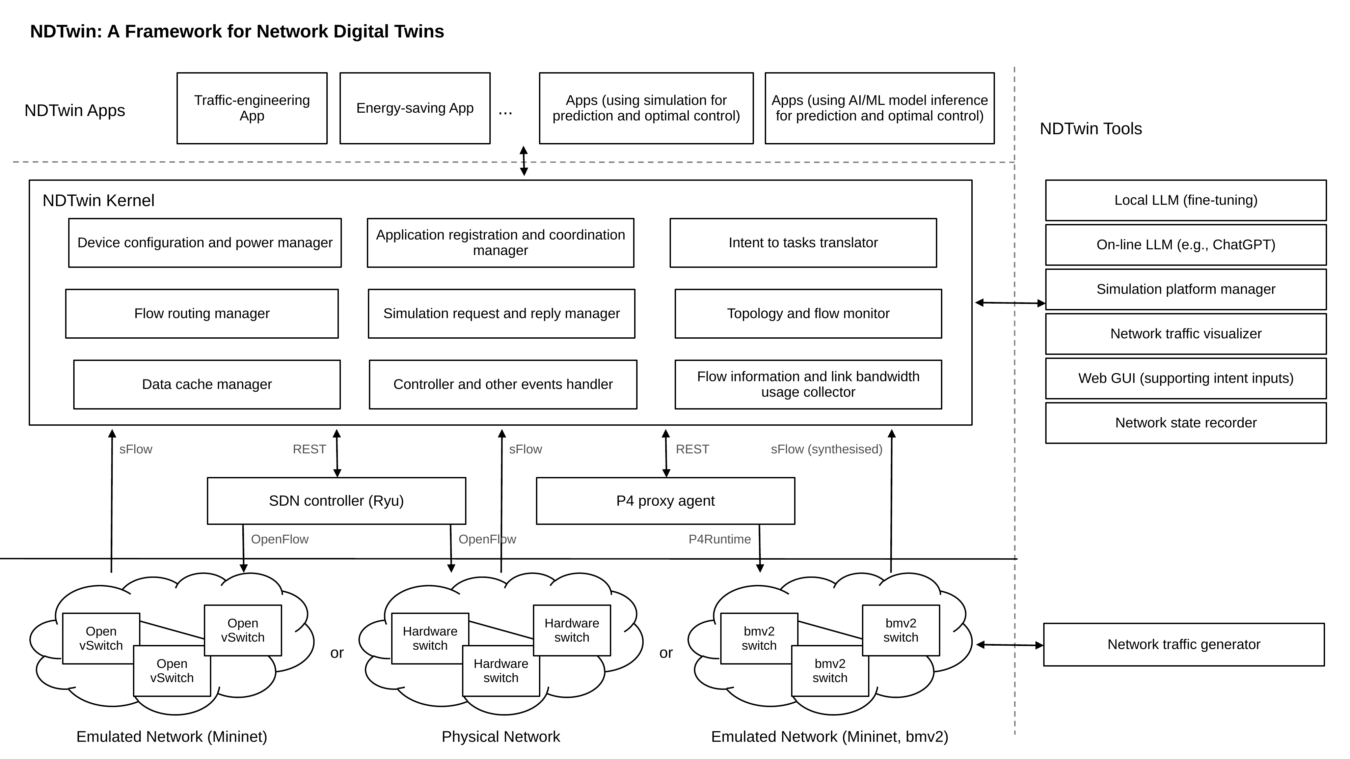
5

Slide 6
SECTION 1
Answering the open questions
Everything in this section was asked for — three written down on 20 August, the rest in the meetings since
6

Slide 7
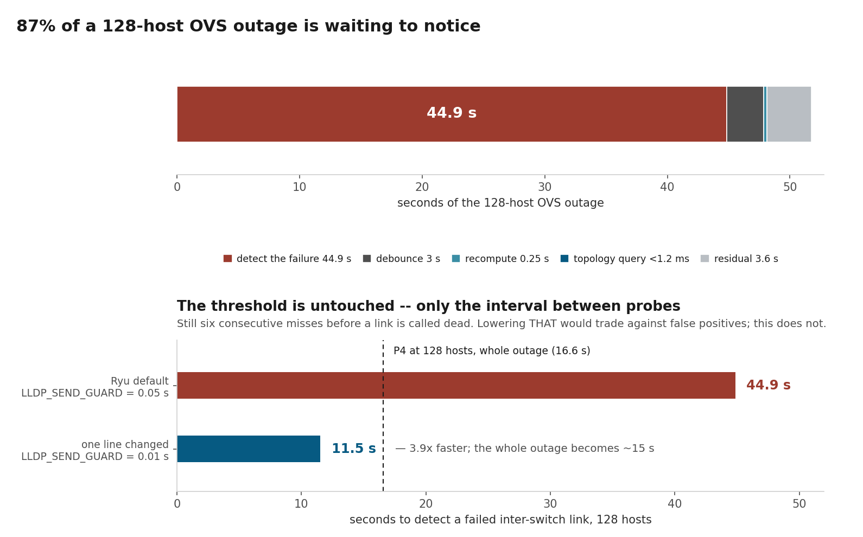
1 · ANSWERING THE OPEN QUESTIONS
7

Slide 8
1 · ANSWERING THE OPEN QUESTIONS
Where the recompute time actually goes
The walk installs 1,280 rules and builds 16,256 path entries — only one of those grows with the square
hosts | rules | install | path entries | report | report %
8 | 80 | 0.007 s | 56 | 0.003 s | 30%
16 | 160 | 0.009 s | 240 | 0.009 s | 50%
32 | 320 | 0.022 s | 992 | 0.052 s | 70%
64 | 640 | 0.044 s | 4,032 | 0.286 s | 86%
128 | 1,280 | 0.103 s | 16,256 | 2.063 s | 95%
One variable per cell
Same live fabric in all five; only the topology model is swapped. Ten real switches, one noise floor.
So “routing is slow” has to be split
The bookkeeping is slow, not the programming of the switches. At 128 hosts the recompute is 0.25 s once the host lookup is indexed.
1
Installing rules is linear
16× the hosts, 14.7× the install. One rule per (switch, destination).
2
Building the path table is super-quadratic
The same 16× costs 688×. One entry per ordered host pair — that is what “16,256 paths” has always meant.
Sweep at 529e021; recompute re-measured at 4810e8f. Method: five sizes, one fabric, one variable.
8

Slide 9
1 · ANSWERING THE OPEN QUESTIONS
Ruling out the controller's topology read path
The kernel re-reads three Ryu topology endpoints on every change — so all three were timed at both fabric sizes
endpoint | 4 hosts | 128 hosts | time | bytes
/v1.0/topology/switches | 0.461 ms / 4,158 B | 1.127 ms / 17,154 B | 2.44× | 4.13×
/v1.0/topology/hosts | 0.346 ms / 812 B | 1.225 ms / 26,345 B | 3.54× | 32.44×
/v1.0/topology/links | 0.449 ms / 7,176 B | 0.797 ms / 7,176 B | 1.78× | 1.00×
Why these hold
n = 20, median, first three discarded. Each cell separated by a full teardown — three different kernel pids, so nothing was inherited.
One assertion missed what moved
1
Under 1.3 ms at both sizes
A fourth endpoint was dropped: byte-identical at both sizes, because the small cell served a path table built for the large one. The probe asserted the host count — against an endpoint the path table is not derived from.
Four orders of magnitude below the 51.75 s being explained.
2
The shape is wrong too — the stronger argument
/hosts ships 32× the data for 3.5× the time. Sub-linear serialisation, the opposite of super-linear work on a bigger graph.
Measured at d9f580b, reported at 2de67b7. Probe and raw JSON in doc/audit/2026-08-21_ryu-topology-scaling/.
9

Slide 10
1 · ANSWERING THE OPEN QUESTIONS
One constant, and what it did not change
Detection is set by how often a port is probed, not by how much evidence is required — only the first of those was touched
1
The probe interval
The threshold is untouched
0.05 → 0.01. Ryu probes every port in turn and sleeps between sends, so the gap between two probes of one port is port-count × guard. At 160 ports: 44.9 s, then 11.5 s.
Still six consecutive misses before a link is called dead. The other lever — dropping that to two — reaches the same number by accepting weaker evidence. That contrast is the point of this page.
2
The recompute
Host lookup indexed, cache token made O(1). The walk goes 2.17 s → 0.25 s.
Judged on false positives, as promised
Three cells, 20 minutes idle each, ~48,000 probe opportunities per window: zero links deleted, zero topology-changed events — and every cell still caught a real injected failure.
3
A spare lever, left off by default
Ports that never answer LLDP can be probed once every N rounds, so detection scales with switches, not ports.
Detection at 07ae07c. Idle only — the loaded case is not measured, and neither default has been changed.
10

Slide 11
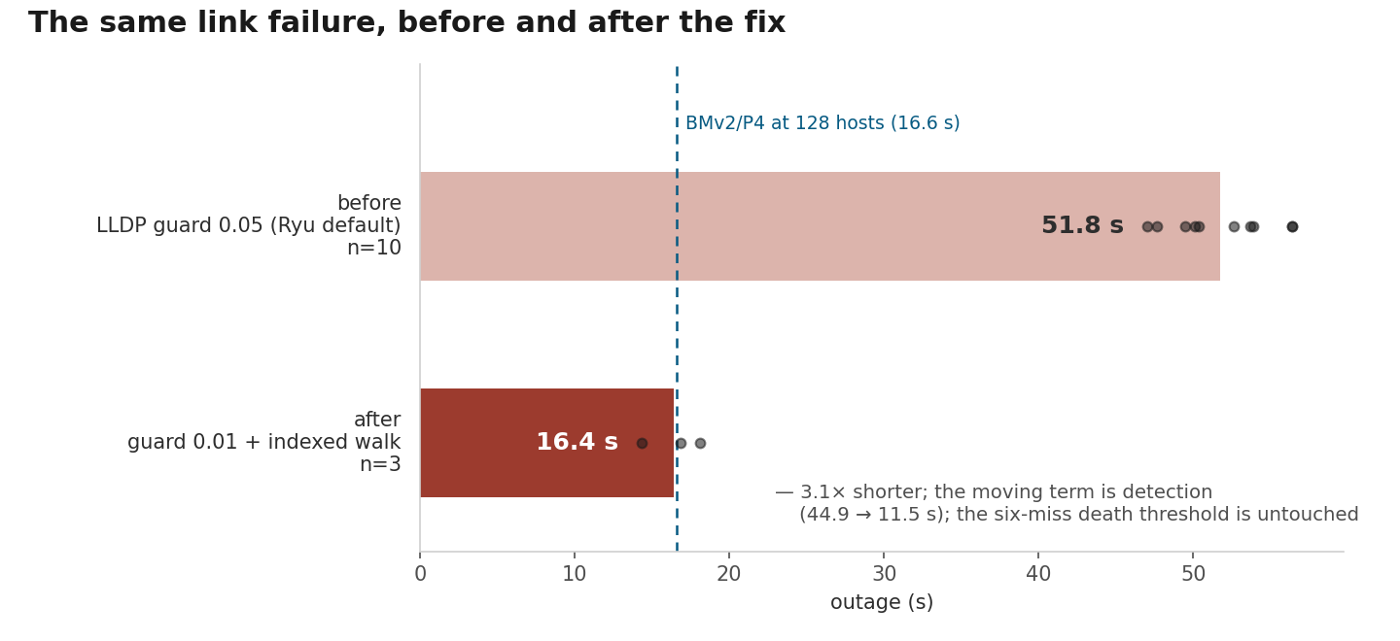
1 · ANSWERING THE OPEN QUESTIONS
11

Slide 12
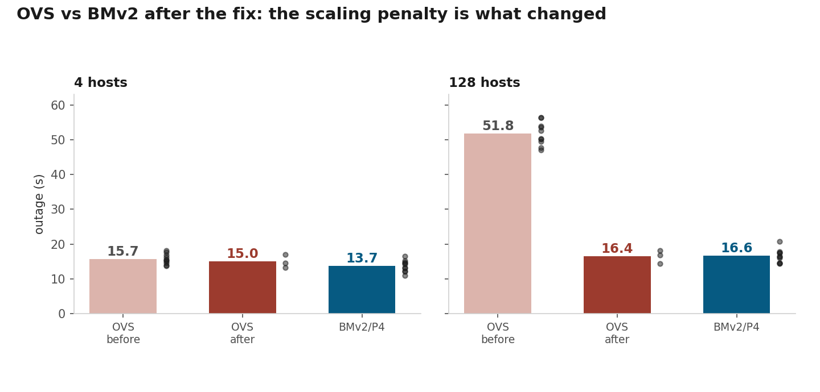
1 · ANSWERING THE OPEN QUESTIONS
12

Slide 13
1 · ANSWERING THE OPEN QUESTIONS
Which bmv2 produced which number
Both builds answer --version with the same string — so this page identifies them by what actually differs
 | stock | fast
path | /usr/local/bin/ | /usr/local/bmv2-fast/bin/
--version | 1.15.3-f0b7d201 | 1.15.3-f0b7d201 ← same
sha256 | 327fa7d1… | 3ff54b5c…
size | 9,576,568 B | 92,147,960 B
build | -O0 -g, logging on | -O3 -march=native, logging off
measured | ~40 Mbps / 3.6k pps | 460–530 Mbps / 50.8k pps
The prerequisite, not the test
The criterion was that the whole L0–L4 suite passes on the fast build. It has not been run. What exists now is the thing that had to come first — being able to say which binary produced a number.
One seam, not two
1
Identify by hash, not by version string
Choosing a binary happens in one place, shared by both topologies.
sha256, BuildID and size separate the two; --version does not.
2
Past -O3 numbers can be attributed backwards
The source SHA is inside the binary's own --version, and that tree is still on disk — so an earlier report calling the -O3 cell unpinnable was wrong.
Provenance at 2c8486a, measured at d9f580b.
13

Slide 14
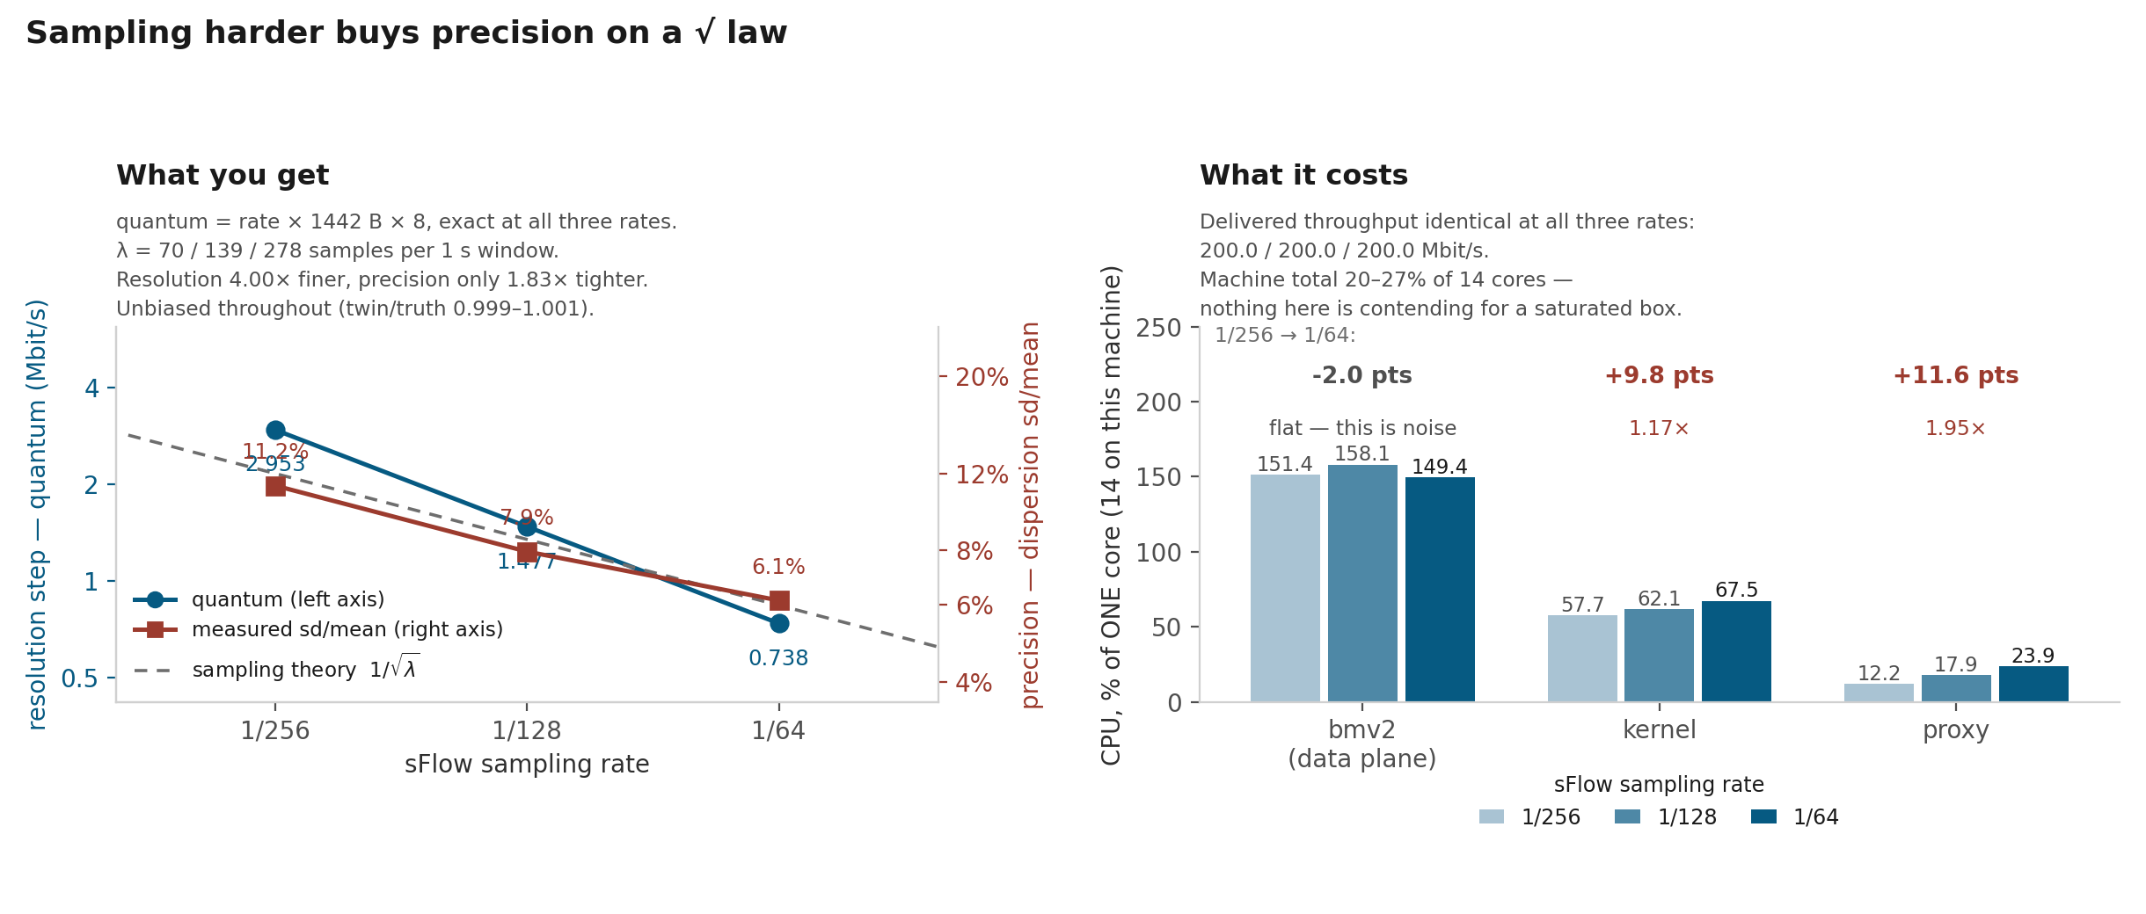
1 · ANSWERING THE OPEN QUESTIONS
14

Slide 15
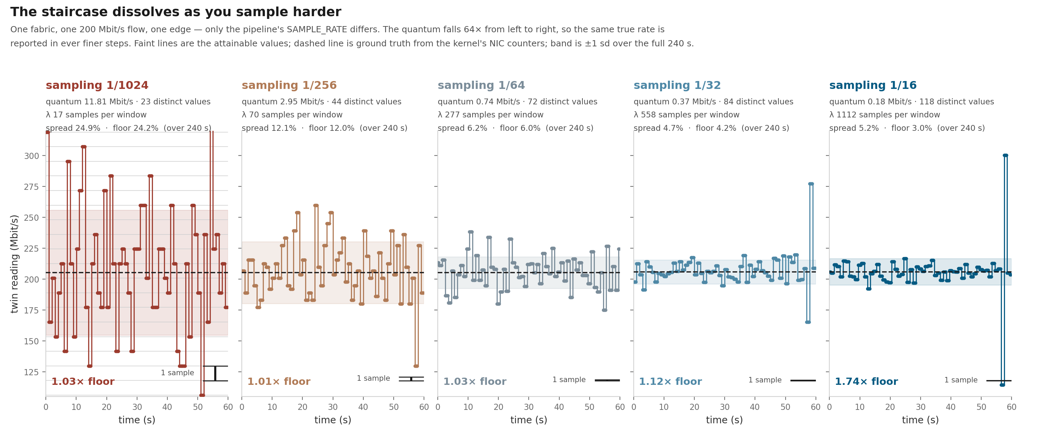
1 · ANSWERING THE OPEN QUESTIONS
15

Slide 16
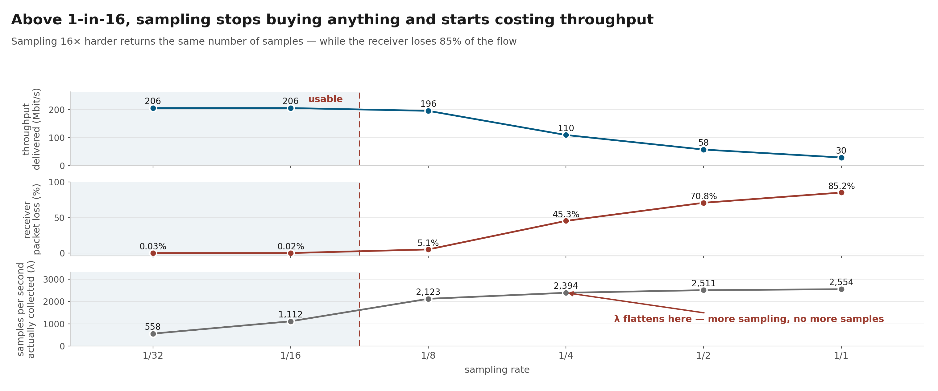
1 · ANSWERING THE OPEN QUESTIONS
16

Slide 17
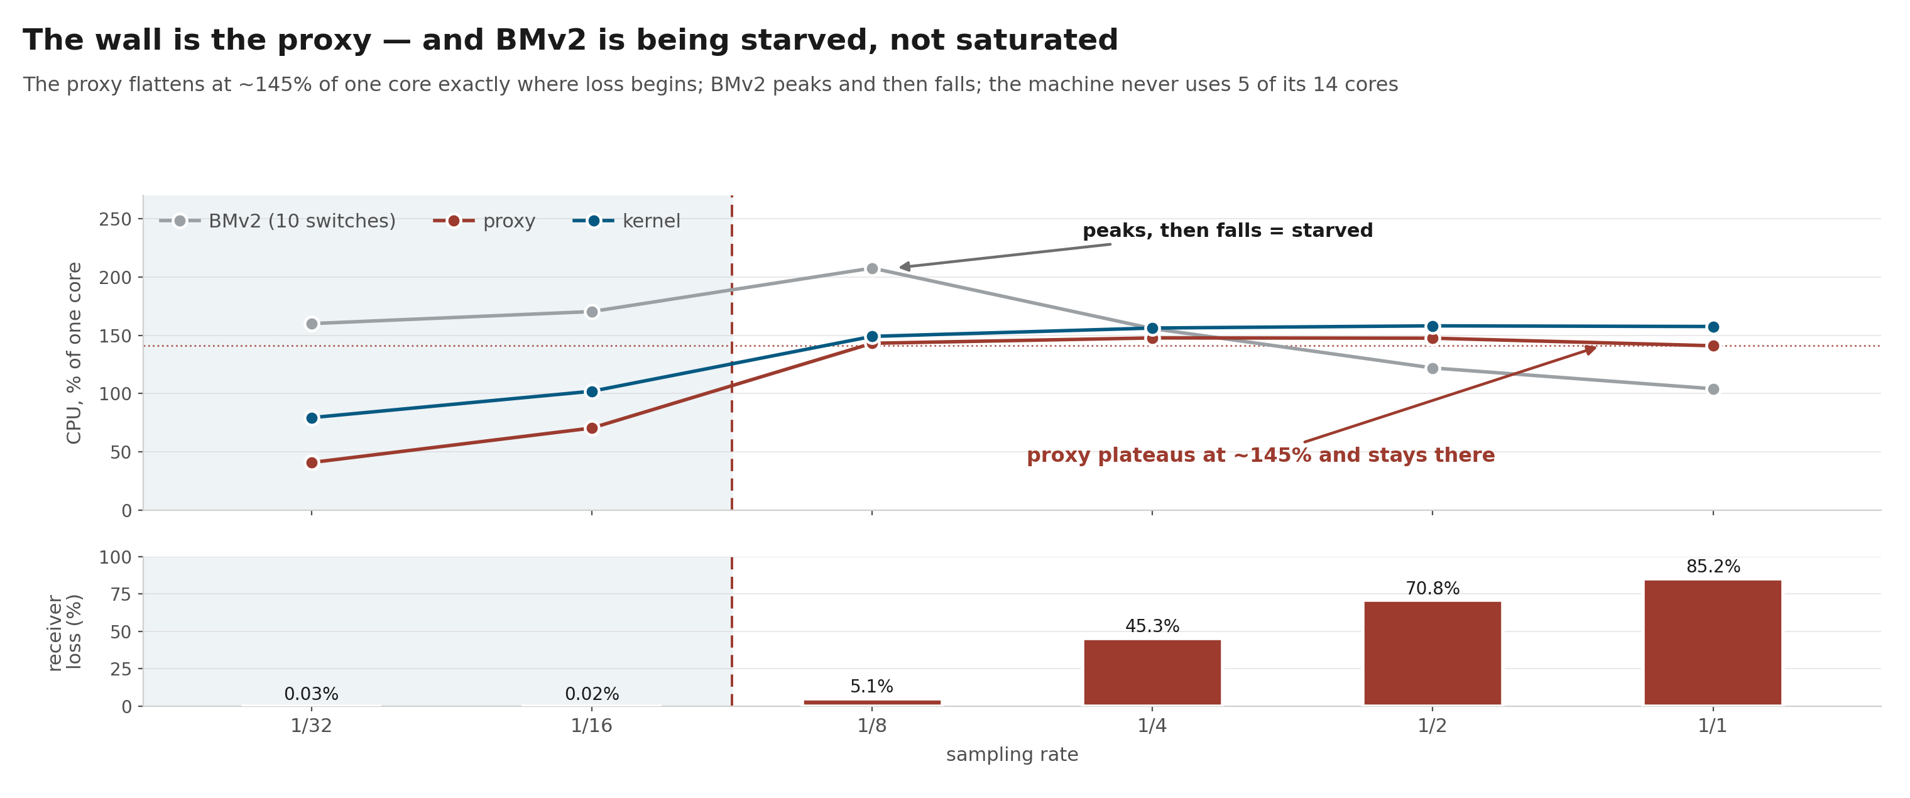
1 · ANSWERING THE OPEN QUESTIONS
17

Slide 18
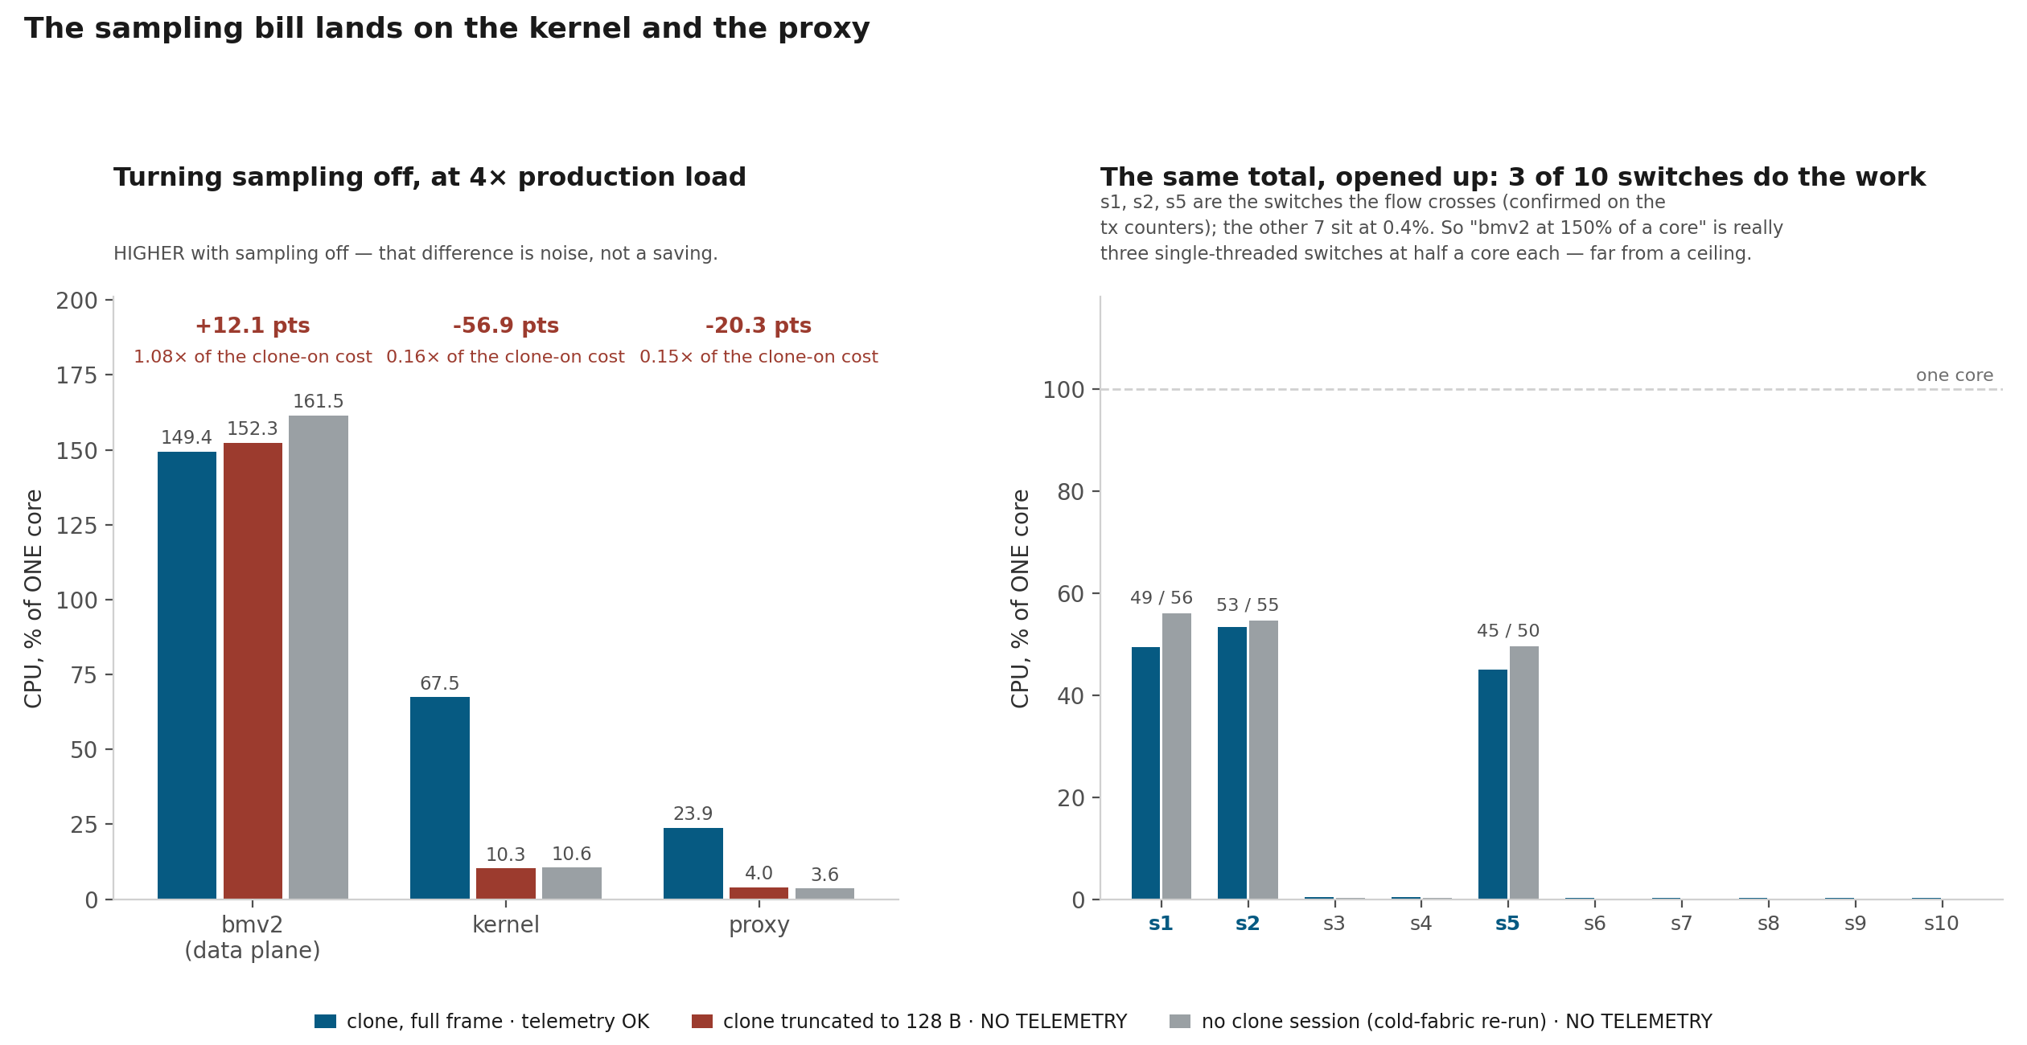
1 · ANSWERING THE OPEN QUESTIONS
18

Slide 19
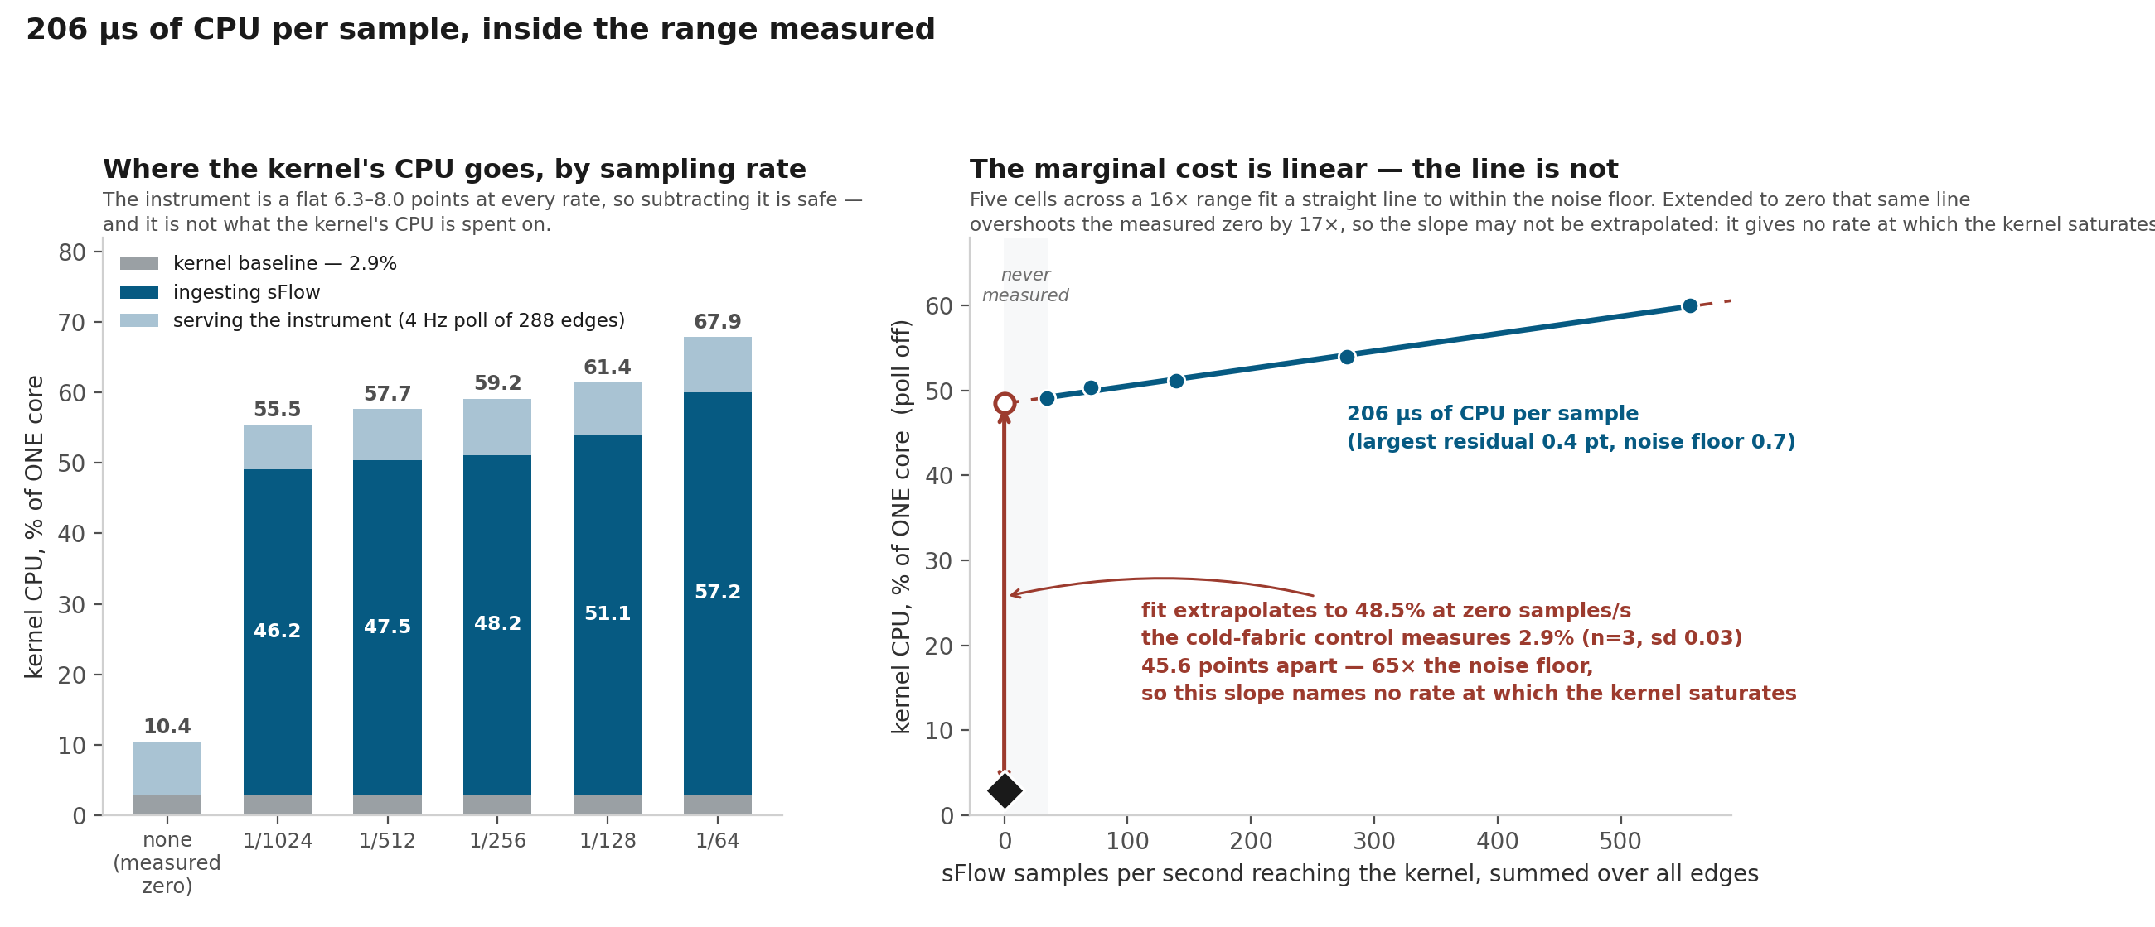
1 · ANSWERING THE OPEN QUESTIONS
19

Slide 20
1 · ANSWERING THE OPEN QUESTIONS
The 45-point thread is not sampling cost
Named from the kernel log of the same boot, not from a thread-id offset — 32× more samples move it by 1%
thread | 1/1024 | 1/32 | what it is
calFlowPathByQueried | 46.31% | 46.84% | a 1 kHz path recompute
run | 3.98% | 13.86% | the sFlow ingest
testCalAvgFlowSendingRates… | 0.00% | 0.00% | never runs
purgeIdleFlows | 0.00% | 0.00% | never runs
Why the threads could be named at all
Both the CPU trace and the kernel log come from the same boot. The earlier round archived no log, and the thread-id offset moves between builds — so those traces can never be mapped back to names.
1
Thirty-two times the samples moves it by one percent
So those 45 points have nothing to do with sampling. It is a full path recompute running at 1 kHz — and it is inherited: present at 28b8b13.
2
The ingest thread is the one that scales
3.98% → 13.86%, a factor of 3.48 as the sample rate rises. That is what sampling actually costs inside the kernel.
Measured at 8c0516d. 46.31% falls between the 45.0 and 46.6 published on 20 August — an independent check on the unit conversion.
20

Slide 21
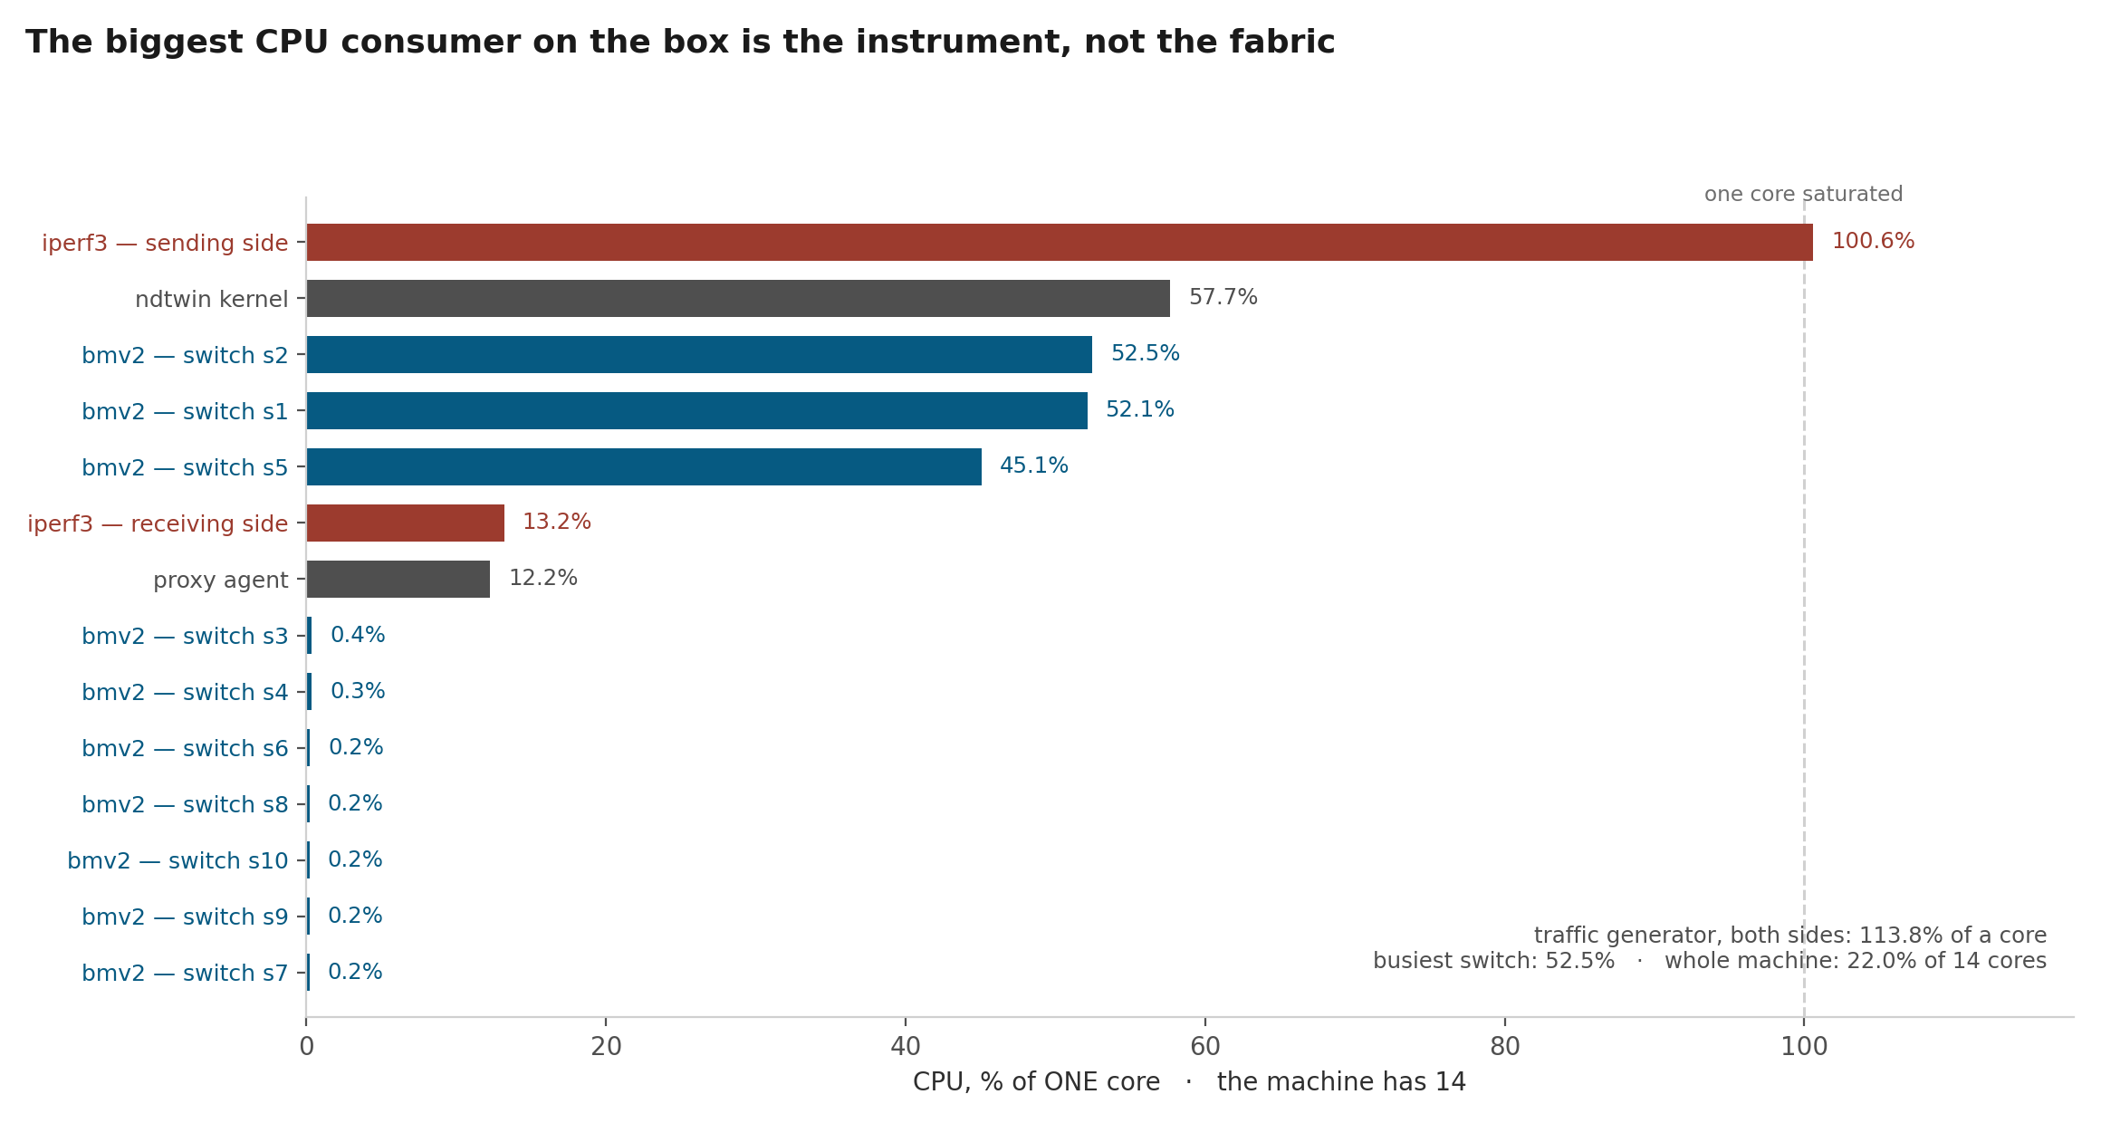
1 · ANSWERING THE OPEN QUESTIONS
21

Slide 22
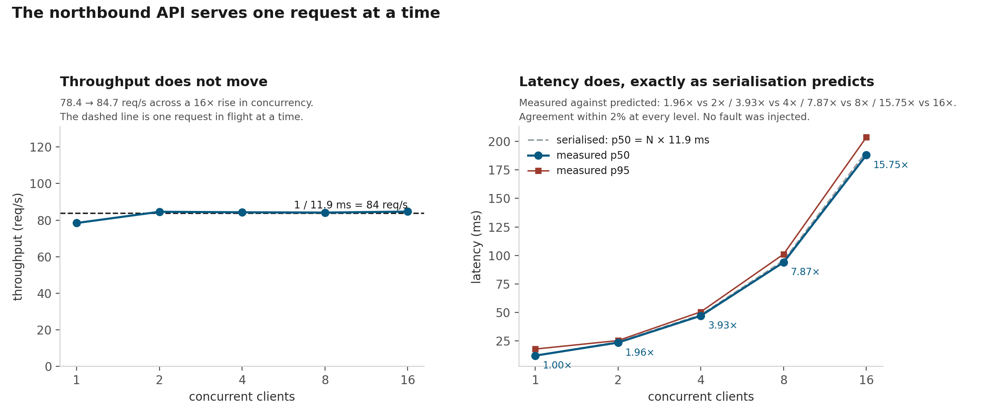
1 · ANSWERING THE OPEN QUESTIONS
22

Slide 23
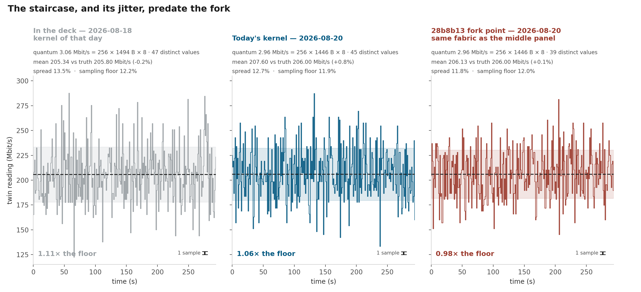
1 · ANSWERING THE OPEN QUESTIONS
23

Slide 24
1 · ANSWERING THE OPEN QUESTIONS
Under concurrency, the twin reads high
Every 128-host measurement until now carried one flow and loaded three switches in ten — this one loads all ten
edge class | as measured | recounted | edges
host → switch | 1.23× | 1.26× | 62 of 122
switch → host | 1.34× | 1.41× | 62 of 128
switch → switch | 1.26× | 1.33× | 8 of 32
OVS, 64 flows | flat to 0.2% | — | all three classes
Why a single ratio is not quoted
Sixteen flows, same settings, two fabric generations: 1.19 on one and 1.03–1.05 on the other. Within one generation the repeats agree to four decimals, so that 14% is not run-to-run noise — it is unexplained. Ratios from different generations are never divided.
What this does not show
Not that scale is the cause. The traffic generator changed at the same time as the host count, so the two are confounded; separating them needs a four-host run with the new generator, which has not been done. The mechanism is unidentified — the shared accounting path is the candidate, on the strength of both planes behaving alike.
1
High on every edge class, well past the noise
The aggregate sampling error floor here is 1.7–2.9%. Twenty-plus points is not it — and four rounds all point the same way.
2
Recounted from the raw with a different method
Different windows, an independently written interface mapping, no filtering of edges: same direction, same size, same ordering of the three classes.
Pre-registered before the run, raw on the audit-raw branch: doc/audit/2026-08-25_large-scale-concurrent/ (dee0512). Recount in the same directory.
24

Slide 25
1 · ANSWERING THE OPEN QUESTIONS
A result we pre-registered, and then withdrew
Six cells said the same sample count does not mean the same precision — the control says we cannot tell them apart
1
What the six cells showed
The rule that made this decidable
Two levels, each reached from opposite directions. The pairing worked — sample counts matched to 0.84% and 0.44% — and every cell was healthy.
The threshold was written down before the run. Afterwards there was a reading that would have rescued the claim — widen it to 0.24 — and taking it is exactly what pre-registration exists to forbid. That is next round's hypothesis, with its own registration.
2
What was about to be claimed
That two cells with the same sample count are not equivalent, so the whole matrix has to be run. It rested on every pair clearing 0.1, and one pair cleared it by 0.040.
Why this page is here at all
3
What the control did to it
The reversal had already been written into a draft of this deck. It came out because the control came back — which is worth more than the six cells were.
Same parameters three times, a full fabric rebuild between each: the spread moved 0.136 on its own, and across the three runs by 0.240. The threshold cannot separate cell from cell.
Pre-registration a7c2bd7; result 8d109f2; control c62bf3e. Sample counts still agree to 1.1%, so the spread is in the measurement, not the design.
25

Slide 26
1 · ANSWERING THE OPEN QUESTIONS
A boot deadlock, and a same-boot A/B
Six of ten boots never converged; the dump names two queues full at the same time — mechanism, fix, and the control
1
The dump names the mechanism
arm | stuck | fidelity | invariant
no fix | 2/3 | 1/3 | violated
deadline | 0/3 | 3/3 | violated
out of loop | 0/3 | 3/3 | holds
Two controller event queues full at once, 12 and 43 senders blocked. The damage is not the stall — it is the kernel's topology poll starving behind it.
2
The fix gives two unbounded waits a deadline
Both inside the handler. The evidence required to call a link dead is untouched. A second fix moves the work out of the loop entirely.
The key cell is not the zero
It is the run where the block did happen — 28 timeouts — and the poll came back on its own after 148 s. That is the fix working, not the fault being absent.
3
The control is a same-boot A/B, within one hour
Same machine, same defaults, alternating arms — drift is bounded by an hour, not a day.
What N = 3 does not buy
At the old rate, three clean runs happen 3.7% of the time by chance. A first verification, not a conclusion.
Pre-registered, with both self-tests: doc/audit/2026-08-25_ring-edge-fix/. Fabric: 128 hosts, 288 edges.
26

Slide 27
SECTION 2
Engineering, and what's next
Bring-up as one command, truncation and batching, and what the next report will carry
27

Slide 28
2 · ENGINEERING, AND WHAT'S NEXT
One command brings the lab up and checks it
Two data planes start in opposite orders and neither fails loudly when reversed — so this page shows what bring-up now enforces
 | starts first | and reversing it looks like
OVS | the control plane | switches dial a dead port; no log line mentions the port, only a topology that never converges
P4 | the data plane | the proxy's first RPC is refused and it exits before opening its own port
Why this belongs in an experiment talk
Before it, every number carried an unchecked assumption: that the testbed was the shape the operator believed. This is that assumption becoming enforced.
1
One number decides everything downstream
Fabric size and the kernel's model both come from the host count. A 128-host fabric beside a 4-host model happened once, silently.
No boot times here, on purpose
Ten boots at defaults, six never converged. “How long a successful boot takes” is a floor, not a number — and that defect is the previous page.
2
Bring-up ends by sending a real packet
Not by reading a status page. Ten green switches over a network carrying nothing has happened twice.
3
Shutdown proves what it killed
Stated as unfinished
Process start time against the pidfile's write time. Names and argv are useless — every service is exec'd through a wrapper.
The claim is a convention, not a lock — it stops the tool's own verbs, not a bare command. Cleanup does not assert what it removed.
28

Slide 29
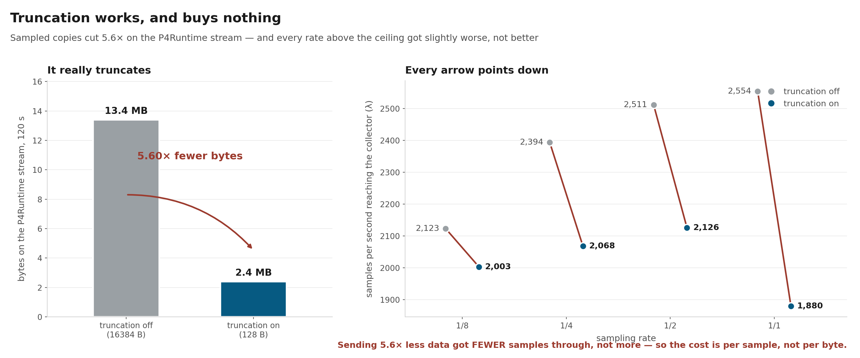
2 · ENGINEERING, AND WHAT'S NEXT
29

Slide 30
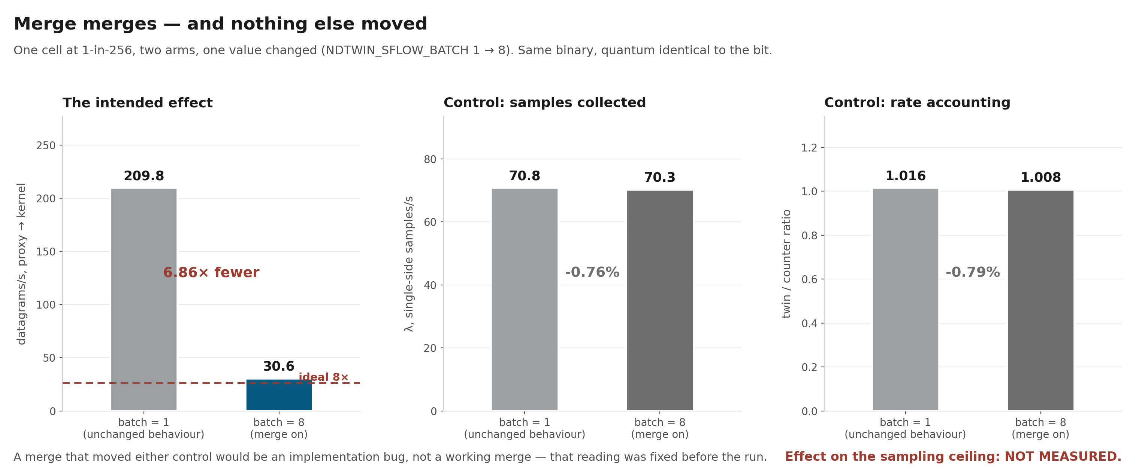
2 · ENGINEERING, AND WHAT'S NEXT
30

Slide 31
2 · ENGINEERING, AND WHAT'S NEXT
Truncation and batching, after the experiments
One cut the bytes and bought nothing; the other cuts the datagrams and has not been asked the question yet
1
Truncation works, and buys nothing
The switch-side knob, for contrast
5.6× fewer gRPC bytes, nothing silent — 35 distinct readings against the control's 32. Yet all four rates move the wrong way. Per-byte was the registered test, and it is out.
Truncating the clone inside the switch reads zero on every edge and reports no error at all. Not an optimisation — an outage. That is why emitter-side truncation is a measured necessity rather than a preference.
2
Merge is wired, and it merges
One variable, batch 1 against 8: datagrams fall 209.8/s → 30.6/s, while the sample count moves 0.8% and the ratio 1.016 → 1.008. Both of those staying flat was the gate.
6.87×, not 8×
518 extra datagrams, which is what a 0.2 s age timer flushing part-full batches looks like.
3
Whether it moves the wall is the open question
The gate proves it can be done, not that it helps. If the cost sits on the send side the wall moves; if it sits on the receive side it will not, and the next cut is receive-side concurrency.
One side effect, recorded not explained
Distinct readings 34 → 14. The total is unchanged; the time grain is not.
Extern A/B at 9424535; merge gate at gate_e.out, independently recounted. Effect on the sampling ceiling: not measured — the 1-in-8 cell has not been run.
31

Slide 32
Planned for the next report
Three again, in the same format — each with the number it starts from and the test that decides it
1
2
3
Take the boot-ring result from suggestive to conclusive
Finish the third question on its own terms
Ask whether batching moves the ceiling
0/3 against 2/3, and the second fix holds the invariant outright — 159 stack samples, no violation. Three clean runs happen by chance 3.7% of the time.
The binaries can be told apart, which was the prerequisite. Swapping the switch binary changes the timing every layer depends on.
Merge is wired and through its gate: 6.87× fewer datagrams with the sample count and the ratio both flat. What that buys at the wall is the part nobody has measured.
Done when the arms reach 0/6 to 0/8 and the boot-success rate is re-measured on the fixed build.
Done when the whole L0–L4 suite passes on the fast build — the test written down on 20 August.
Done when the 1-in-8 cell — the first rate that loses packets — is run with batching on and off, and the loss either moves or does not.
Same shape as the 20 August page, so the next report can be checked against it the way this one was.
32

Slide 33
Where it stands
What is settled, what is run but not finished, and what is still unknown
Settled
Open, and stated as open
The 128-host failover budget balances
Boot convergence
six of ten boots at defaults; fix verified at N = 3 only
Detection is 87% of it, and the cause is arithmetic: hosts stretch the gap between two probes of one port.
Fast build as default
the L0–L4 acceptance run is scheduled, not done
Detection is 3.9× faster, threshold untouched
One constant. Idle false-positive rate zero across ~10⁵ probe opportunities.
Loaded false positives
the idle rate is zero; under load it is unmeasured
A sample has a price — on the kernel and the proxy
Scale × concurrency
the direction holds; the size moves 14% between fabric generations
206 µs per sample inside the range run; flat on the switches across a 4× change in rate.
The intercept
206 µs/sample is a marginal cost inside a range, not a ceiling
Sampling harder stops paying at 1-in-32
The ceiling's mechanism
receive-side, per sample — inferred, not identified
Above 1-in-16 it costs throughput instead — 85% of the flow lost at 1-in-1.
Batching (merge)
wired and gated; what it does to the wall is unmeasured
Truncation is not the fix
5.6× fewer bytes moved the ceiling by nothing. The cost is not per byte.
Northbound concurrency
one lane, measured; not yet a problem, not yet addressed
Under concurrency the twin reads high
Residual in the budget
3.6 s across noise and an epoch difference — not explained
Four rounds, three edge classes, and an independent recount agrees. How high is not settled.
The three marked items are what the next report answers; the rest are in doc/KNOWN-ISSUES.md.
33

